Slide 1
Customer purchase analytics for e-commerce platform
Pushparaj M / BADM-WD-T-B9

Slide 2
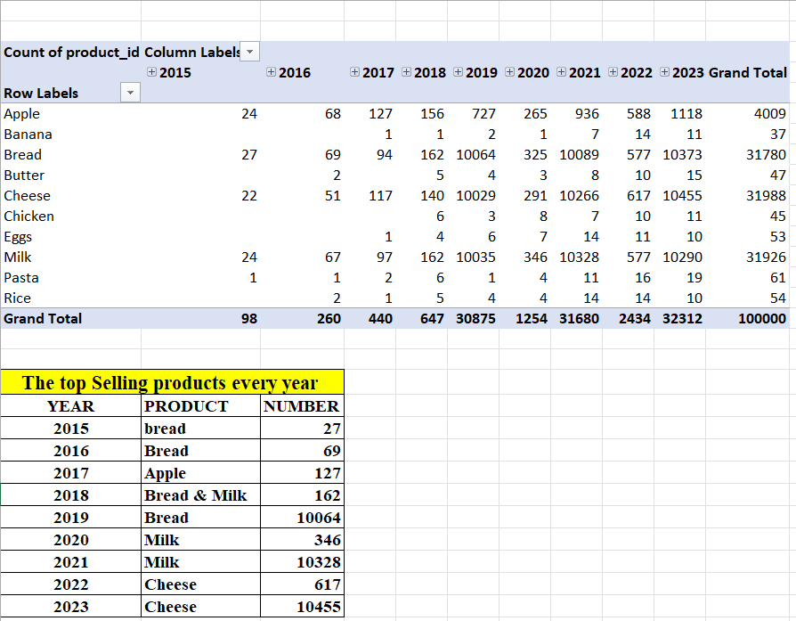
Data Analytics Tasks A. Basic aggregation : 1. Find the total number of purchases per product per year and list down the top selling products every year.

Slide 3
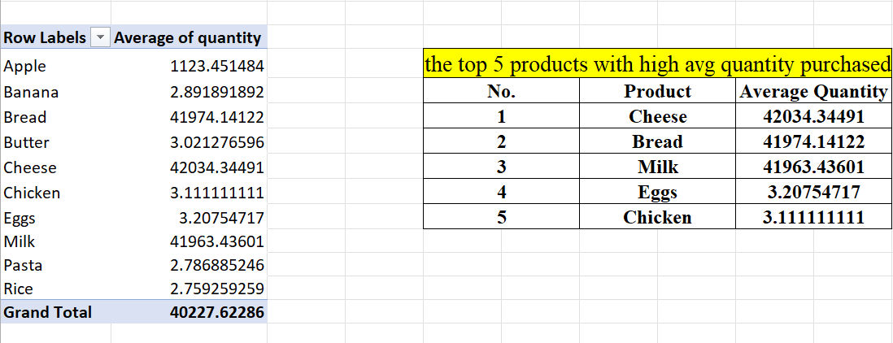
2. Calculate the average quantity purchased per product and list down the top 5 products with high avg quantity purchased.

Slide 4
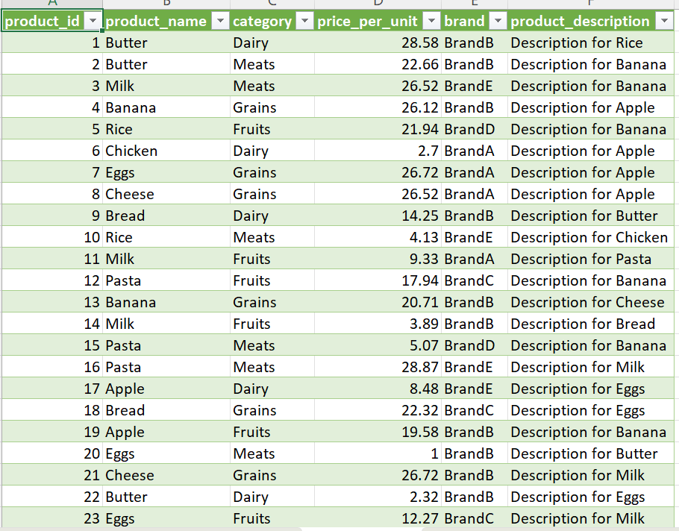
B. Join operations: 1. Join purchase history with products dataset to get the product name for each purchase.

Slide 5
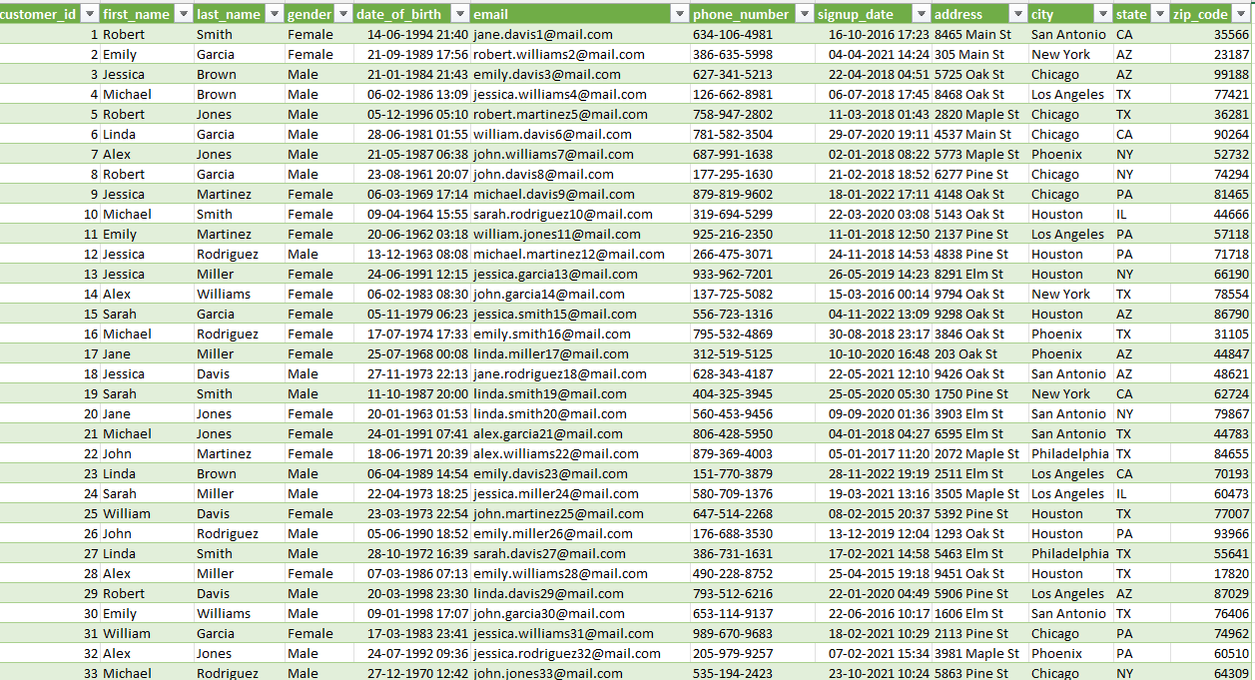
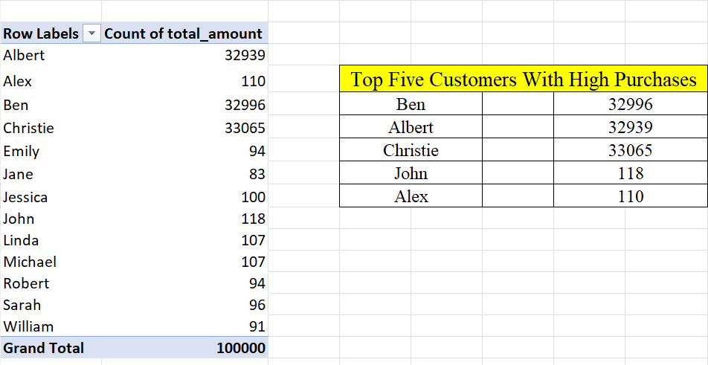
2. Join purchase history with customer profile dataset to include customer information for each purchase and list top 5 customers with high purchases.

Slide 6
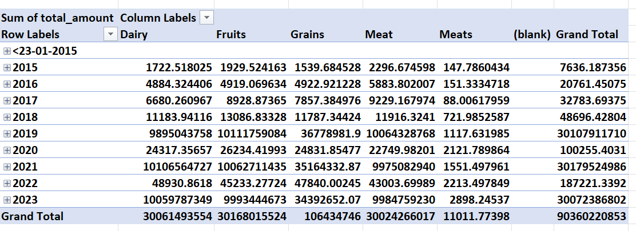
C. Window functions: 1. find the cumulative sum of purchases for each product category over year.

Slide 7
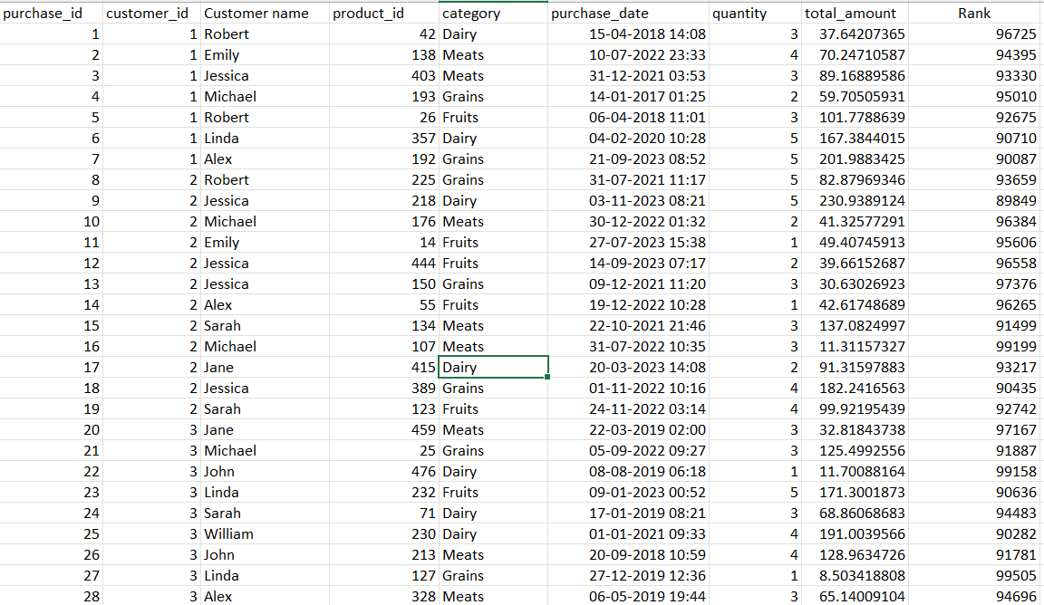
D. Rank and dense rank: 1. Rank customers based on their total expenditure.

Slide 8
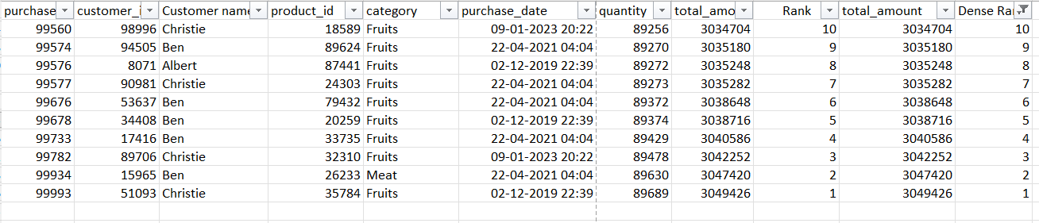
2. Identify the top 10 customers by purchase frequency using DENSE_RANK().

Slide 9
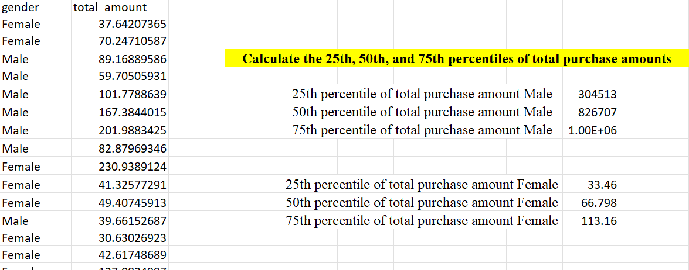
E. Percentiles: 1. calculate the 25th, 50th (median), and 75th percentiles of total purchase amounts for each customer segment.

Slide 10
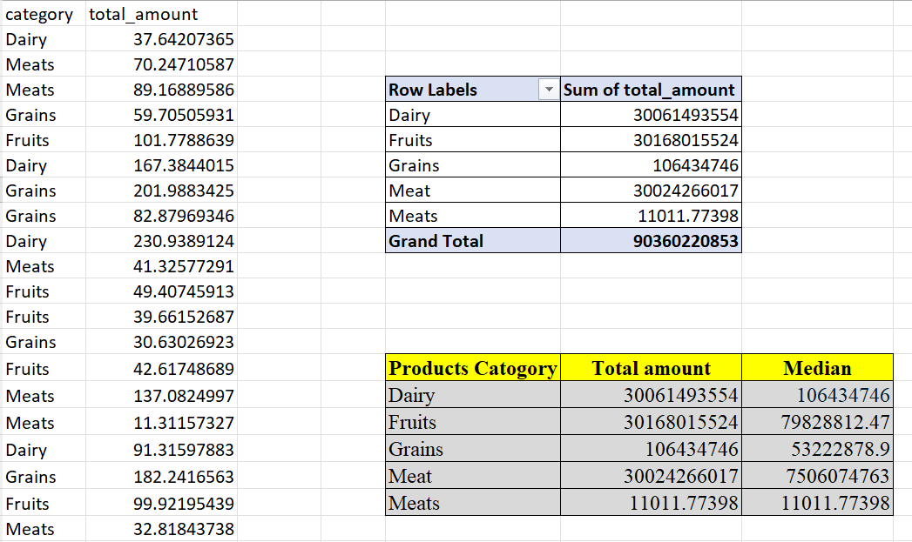
F. Median calculation: 1. Compute the median purchase amount per product category.

Slide 11
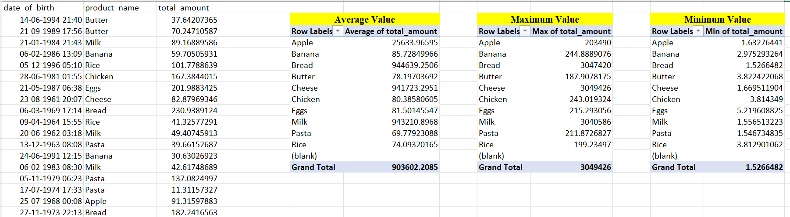
G. Complex aggregation: 1. Find the average, maximum, and minimum purchase value for each product type and customer age group.

Slide 12
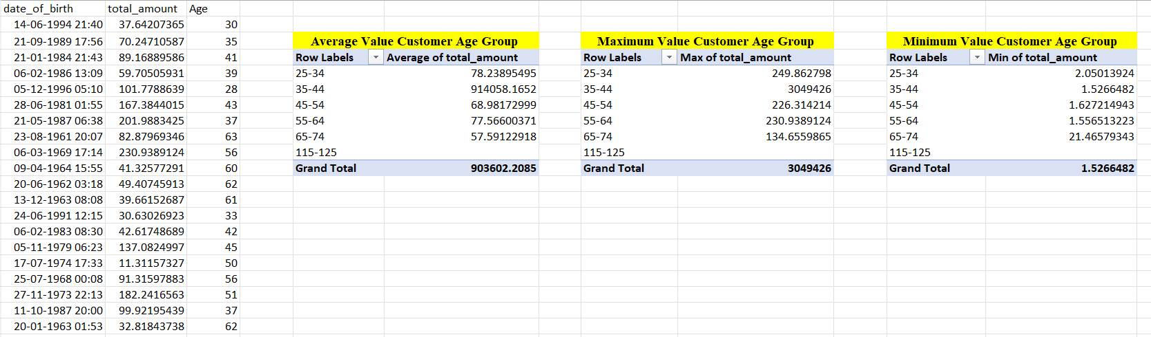
Customer age group:

Slide 13
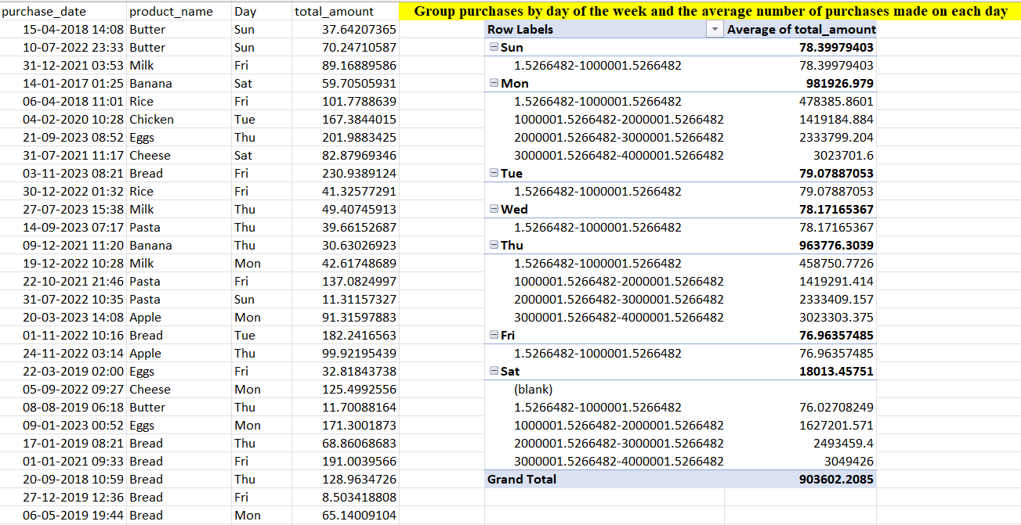
H. Grouping: 1. Group purchases by day of the week and find the average number of purchases made on each day.

Slide 14
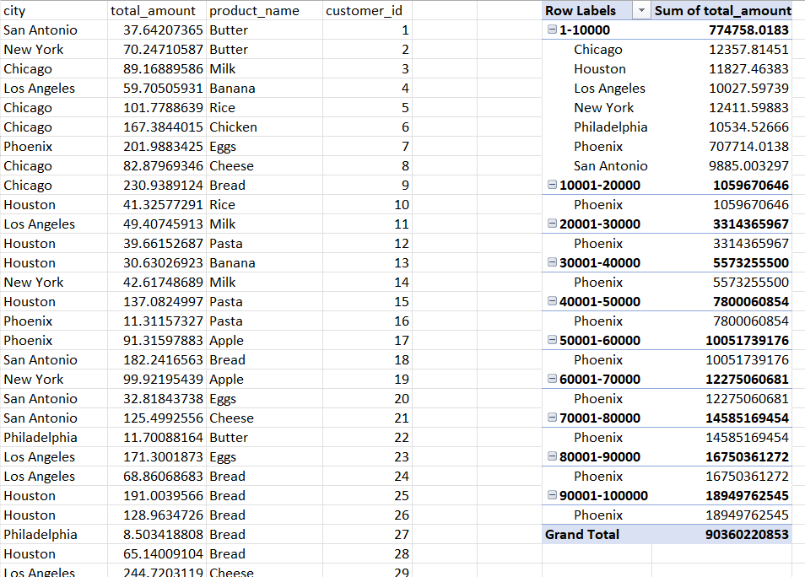
2. Group customers by city and find the total number of purchases and total revenue generated.

Slide 15
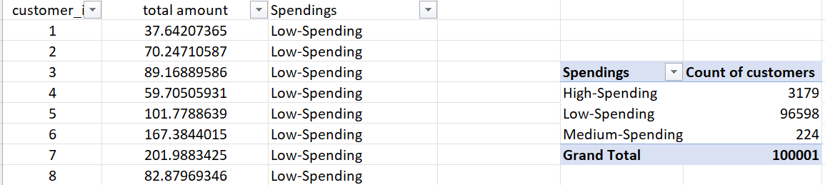
I. Case statement: 1.Classify customers as “high-spending,” “medium-spending,” or “low-spending” based on their total purchase amounts (using percentiles in multiples of 33).

Slide 16
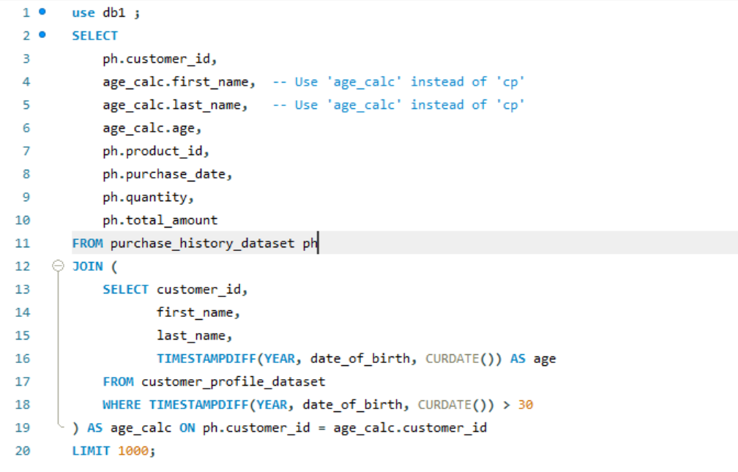
J. Join with condition: 1. Join purchase history with customer profile dataset where the customer’s age is above 30, and display their purchase details.

Slide 17
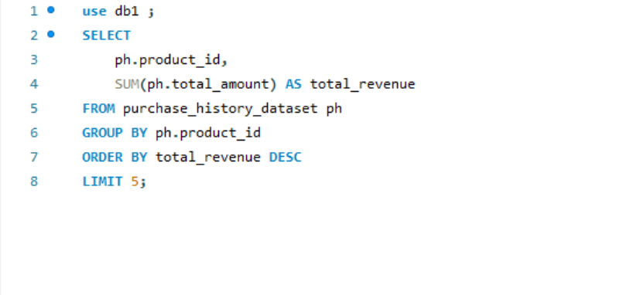
K. Top N analysis: 1.find the top 5 products contributing to the highest revenue.

Slide 18
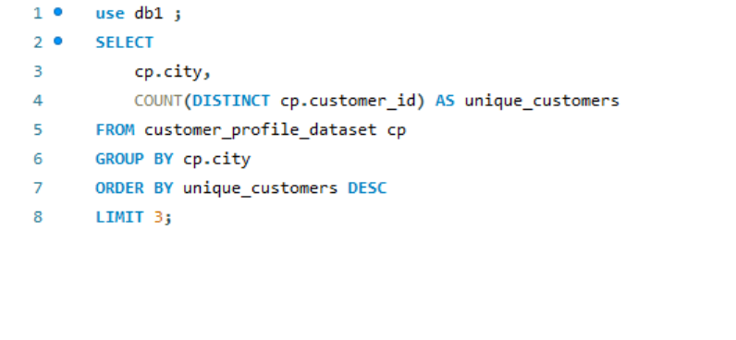
2. Identify the top 3 cities with the greatest number of unique customers.

Slide 19
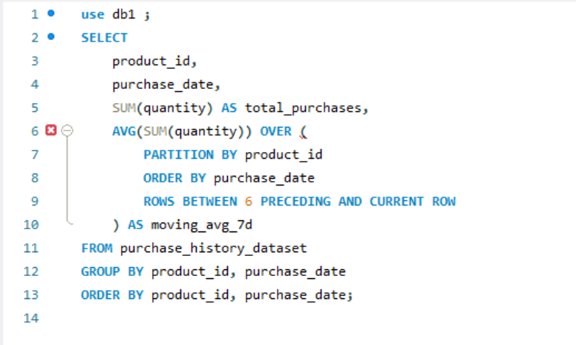
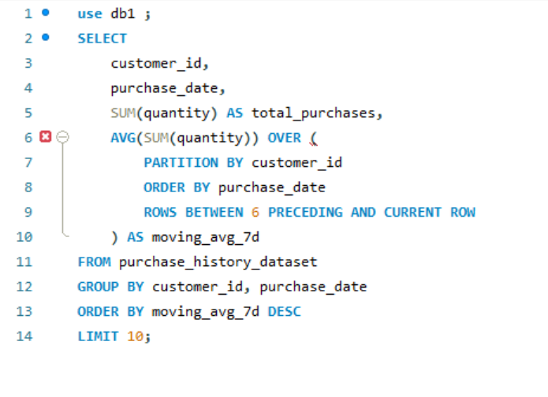
L. Window functions for trend analysis: 1. Create a 7-day moving average of total purchases per product and which customer had high 7 day's MA

Slide 20
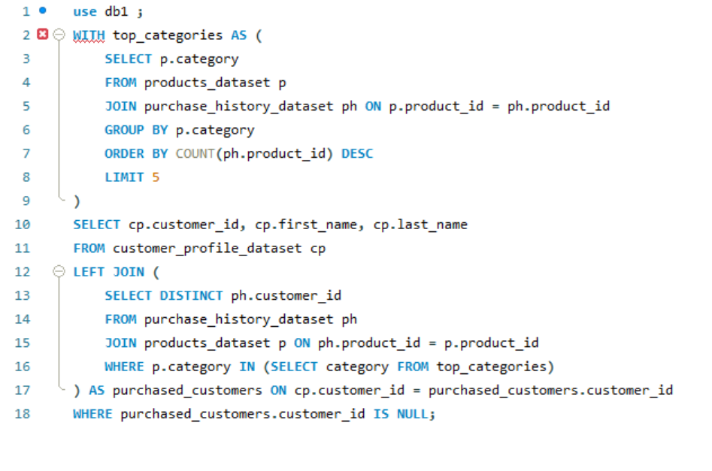
M. Nested queries: 1. Find customers who have never purchased products from the top 5 most popular categories.

Slide 21
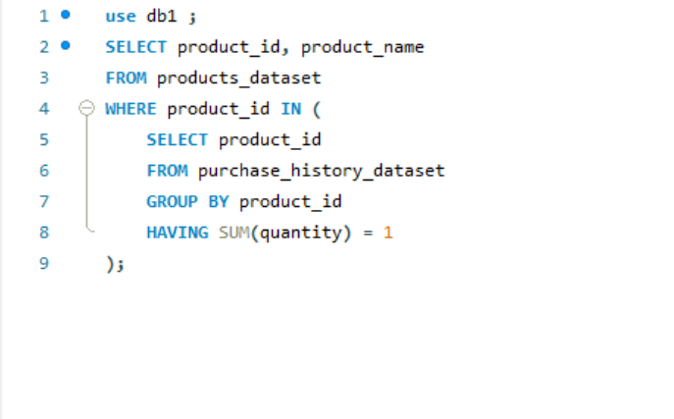
2. Identify products purchased only once in the entire dataset.

Slide 22
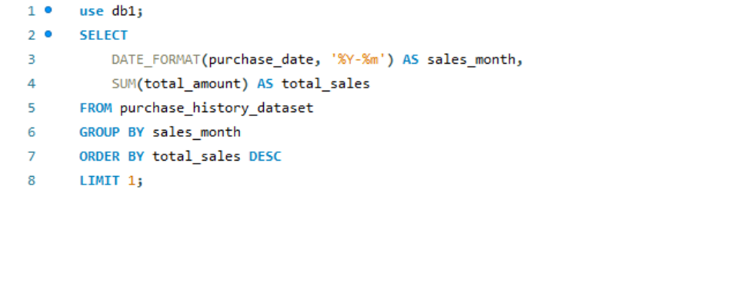
N. Date analysis: 1. Identify the month with the highest total sales volume.

Slide 23
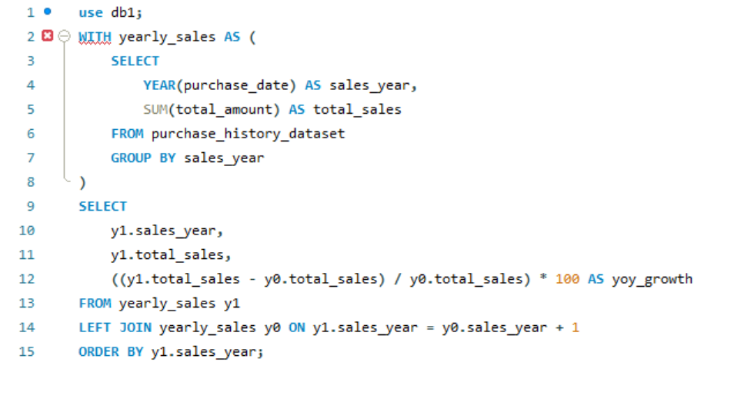
2. Calculate the year-over-year growth of total sales.

Slide 24
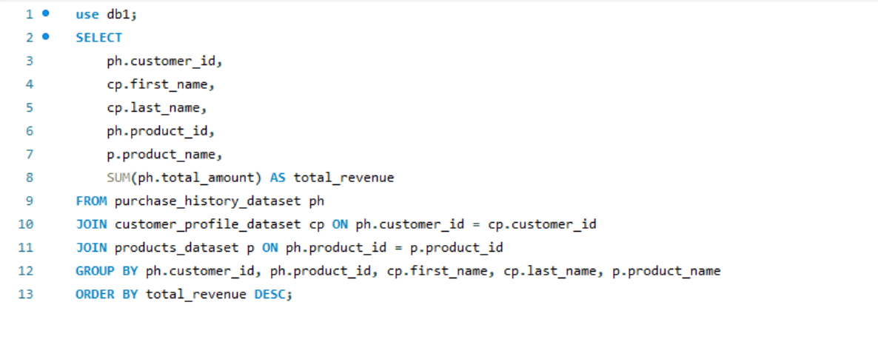
O. Join with aggregation: 1. Join all three datasets to find the total revenue per product per customer.

Slide 25
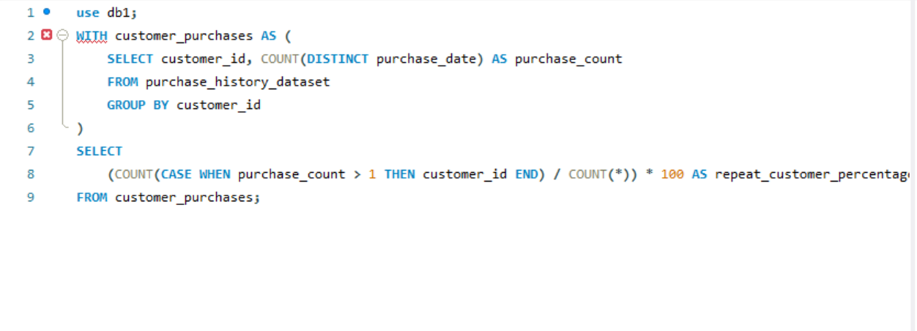
P. Customer retention: 1. Find the percentage of repeat customers in the dataset.

Slide 26
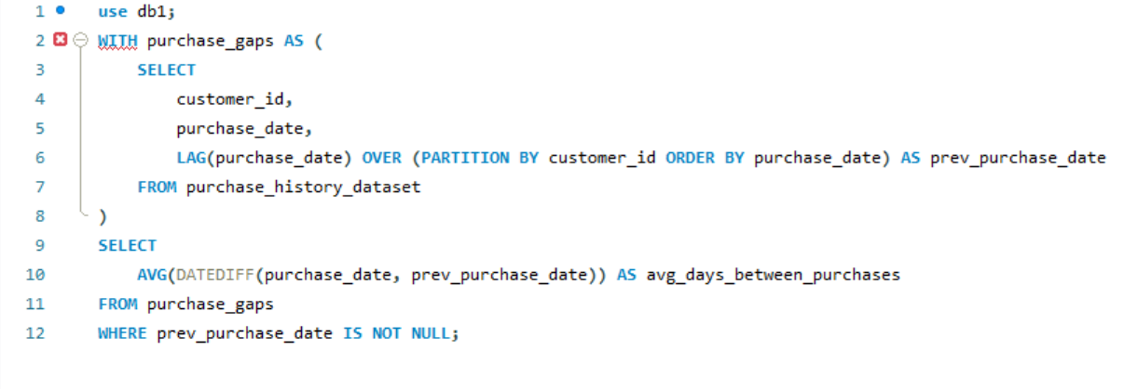
2. Calculate the average number of days between purchases for repeat customers.

Slide 27
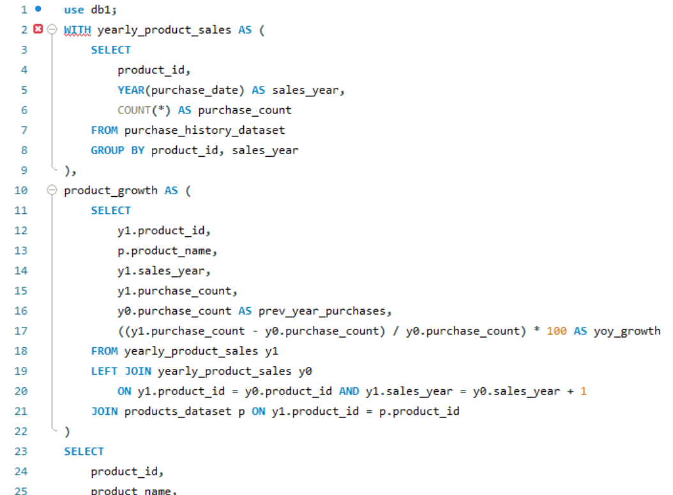
Q. Time series analysis: 1. Find the products with the highest growth in purchase frequency over time (average purchase YOY).

Slide 28
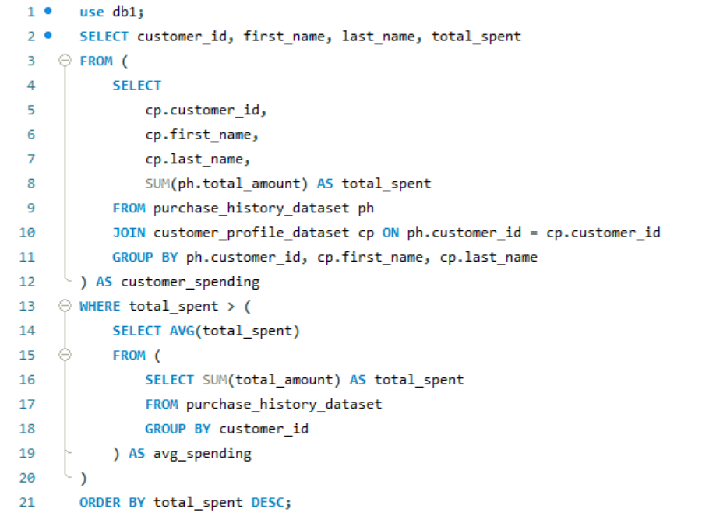
R. Subqueries: 1. Identify customers whose total expenditure is above the average expenditure of all customers.

Slide 29
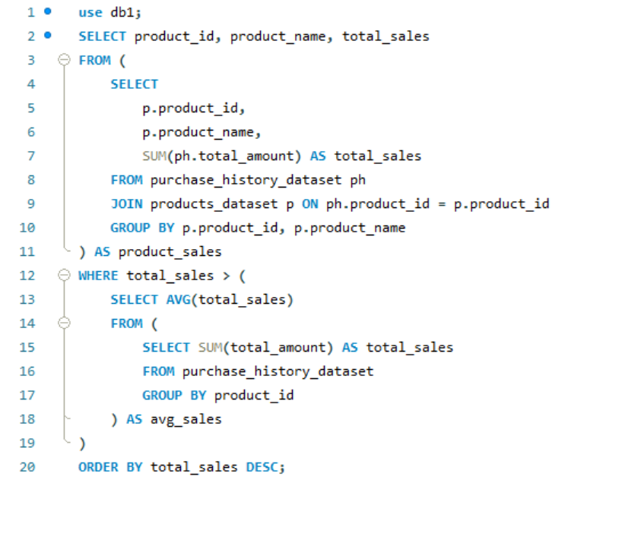
2. Find products with a purchase amount higher than the average purchase amount across all products.

Slide 30
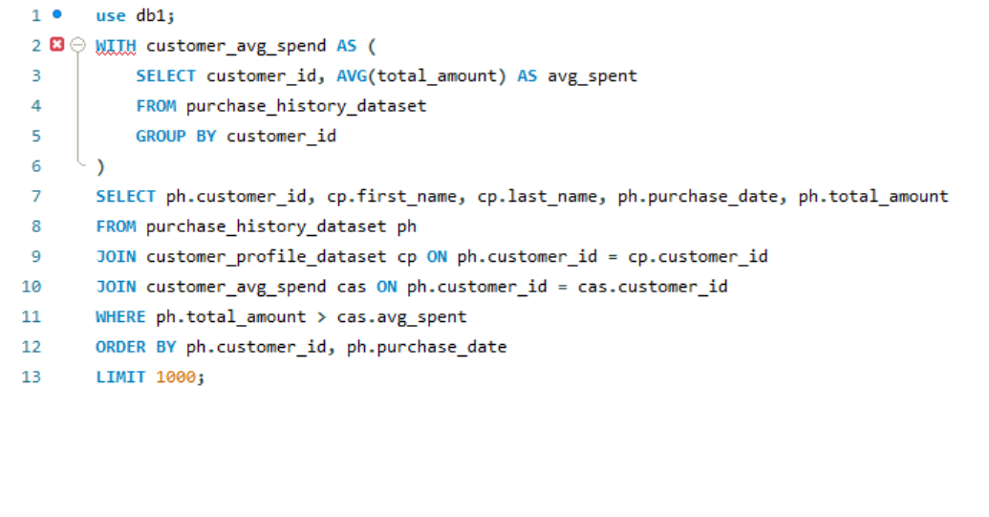
S. Correlated subqueries: 1. Find the purchase dates where a customer made a purchase larger than their average purchase amount.

Slide 31
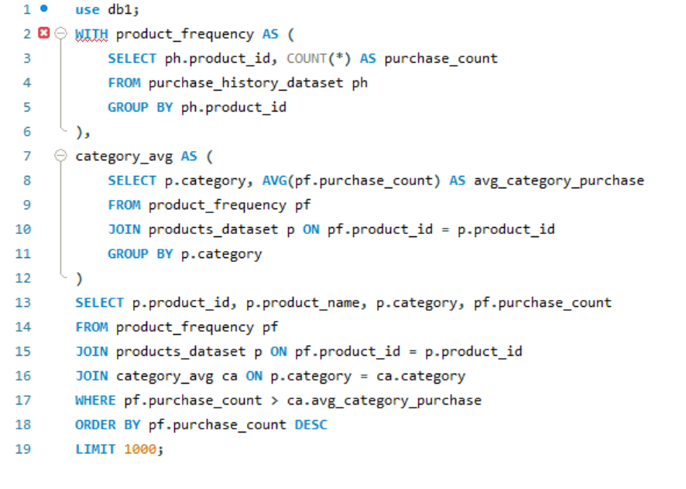
2. List all products that were purchased more frequently than the average frequency of products in their category.

Slide 32
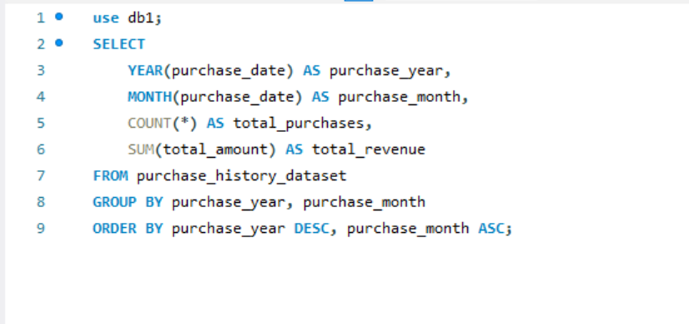
T. Date functions: 1. Extract the day, month, and year from the purchase date, and group total purchases by month across all years

Slide 33
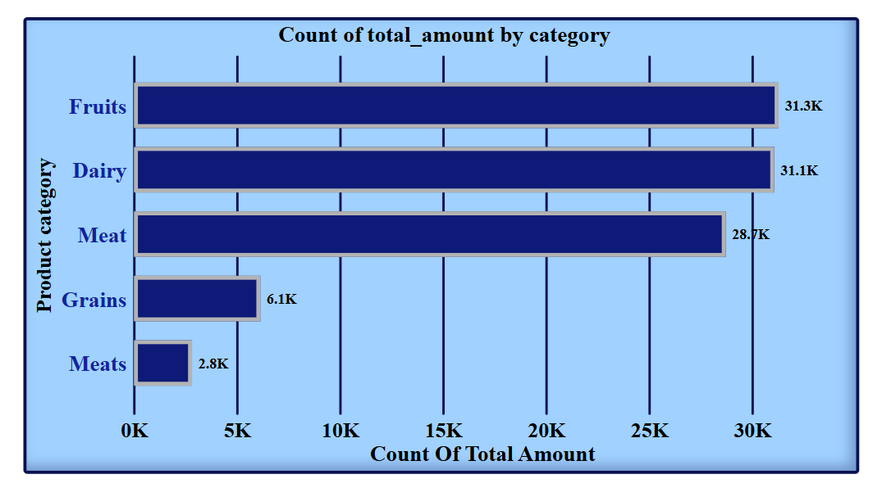
U. Visualization in power BI: 1. Create a bar chart showing the total purchases per product category.

Slide 34
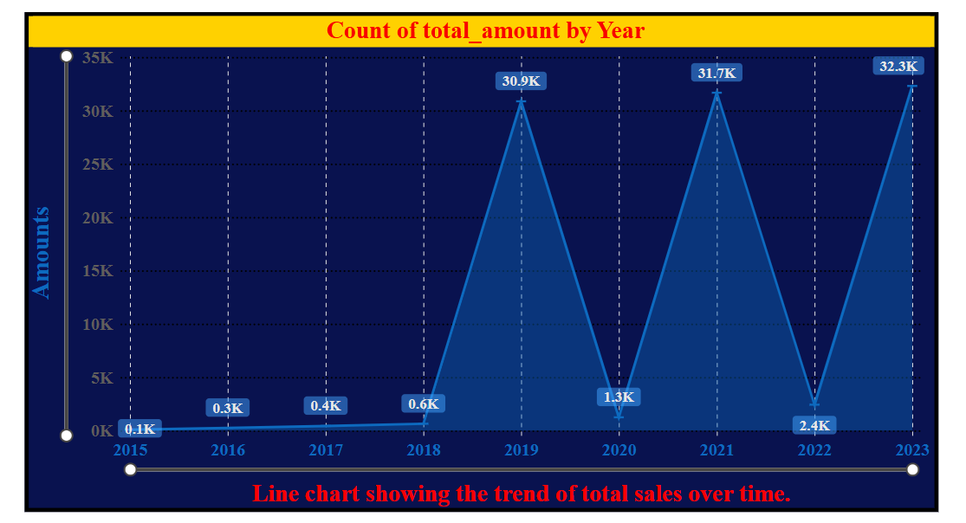
2. Build a line chart showing the trend of total sales over time.

Slide 35
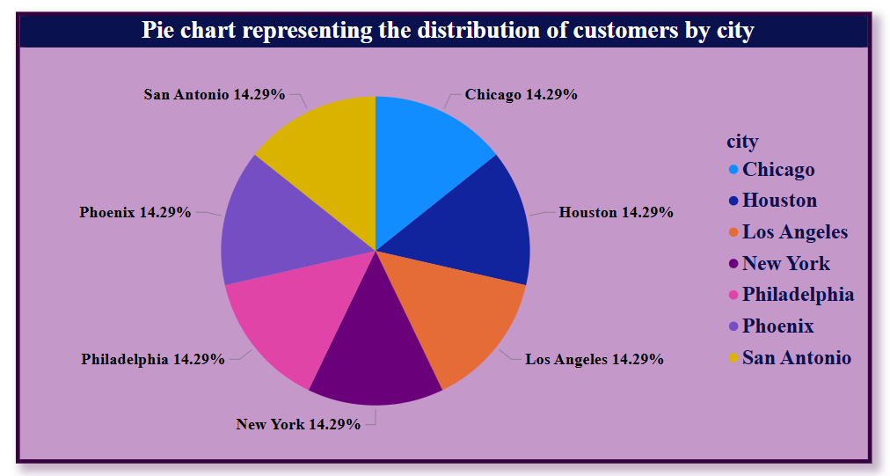
3. Design a pie chart representing the distribution of customers by city.

Slide 36
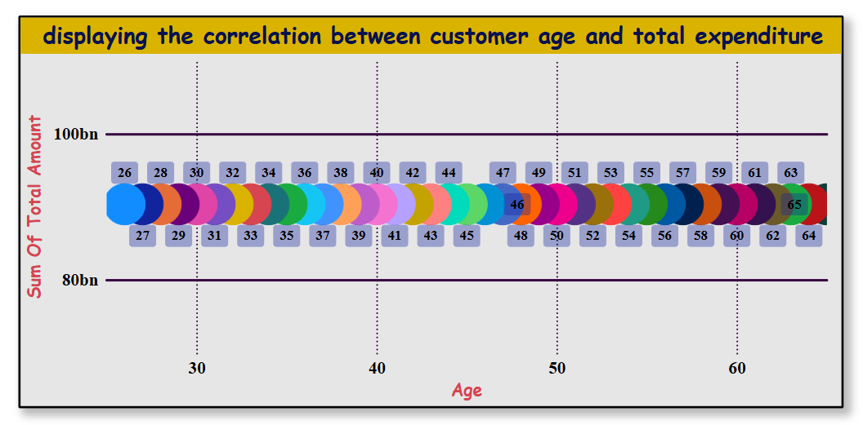
4. Implement a heat map displaying the correlation between customer age and total expenditure.

Slide 37
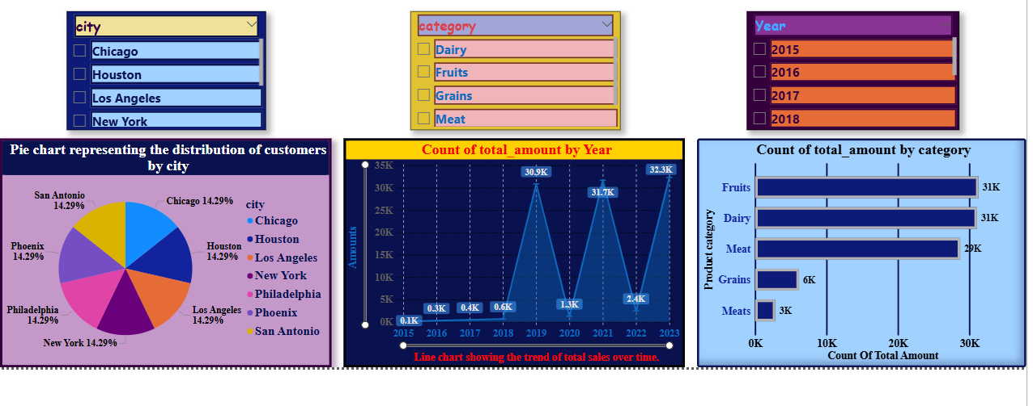
5. Use slicers to filter data by product category, customer age group, and city.

Slide 38
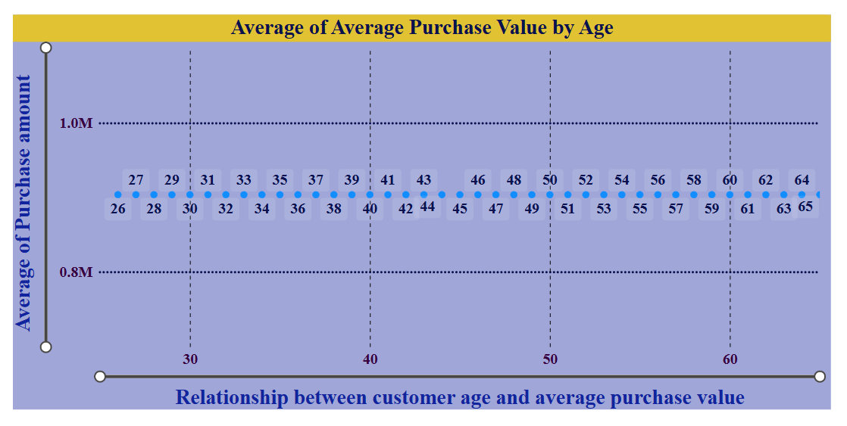
V. Advanced visuals: 1. Implement a scatter plot to visualize the relationship between customer age and average purchase value.

Slide 39
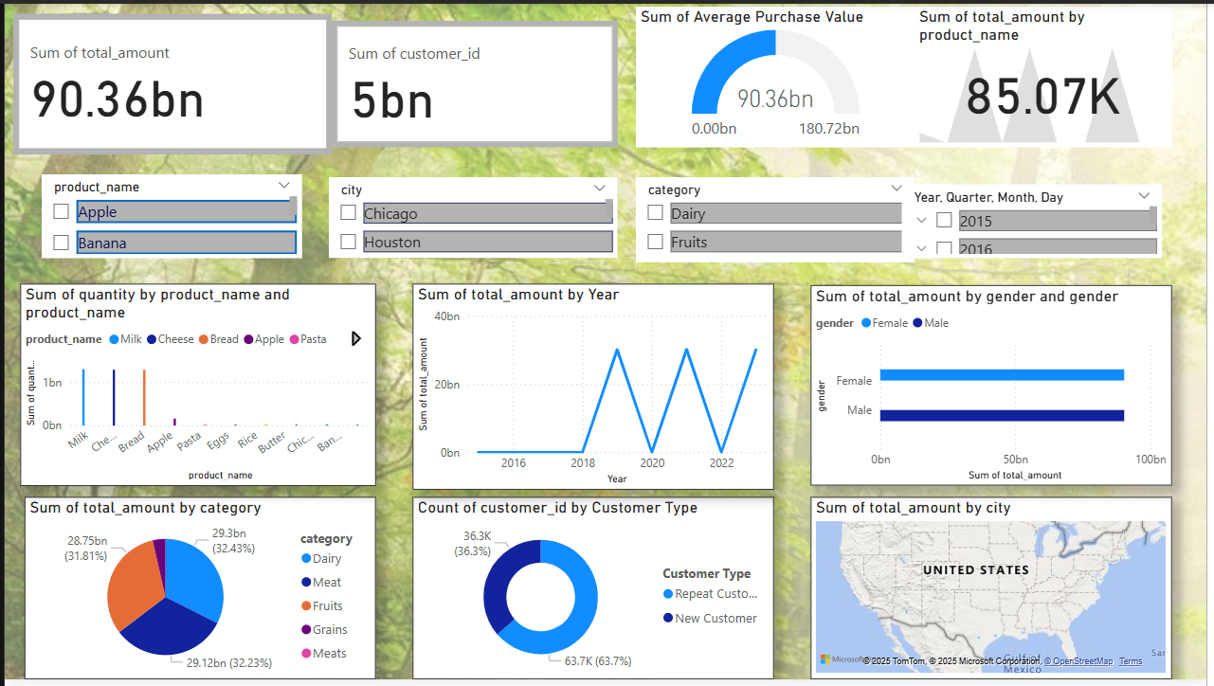
W. Power BI dashboard: 1. Combine multiple visualizations into a dashboard summarizing key performance indicators like total revenue, top customers, and popular products.

Slide 40
Thank You

